Slide 2
SMALL CONTRACTORS INITIATIVE
SESSION 5
WORKING CAPITAL AND LOAN APPLICATIONS

Slide 3
SESSION OVERVIEW
Introduction
PART A: WORKING CAPITAL NEEDS
  What Is Working Capital?
  Definitions and Needs
  Cashflow
  Disbursement Management
  Projections
  Sources
  SBA Programs
  Next Steps and Resources
PART B: LOAN APPLICATIONS
  Introduction and Learning Objectives
  Lender’s View of Underwriting
  The Five C’s of Business Assessment
    Character, Capacity, Capital, Collateral, Conditions
  Issues and Strengths
  Loan Types
  Select a Lender
  Readiness Checklist
  Additional Issues
Loan Application Exercise
Next Step
Resources

Slide 4
INTRODUCTION
SBA bond guarantees require sufficient working capital.
Session helps firms determine working capital needs.
This session is based on assumptions from Session 3: Business Planning.

Slide 5
PART A:
WORKING CAPITAL NEEDS

Slide 6
PART A: LEARNING OBJECTIVES
Define working capital.
Understand that SBA bond guarantees require sufficient working capital and cashflow.
Use spreadsheets to project working capital needs.
Select one working capital loan source to approach.

Slide 7
WHAT IS WORKING CAPITAL?
The difference between current assets and current liabilities.
(U.S. Small Business Administration)
It is business capital that is used in day-to-day operations.

Slide 8
NET WORKING CAPITAL
CURRENT ASSETS
Cash, marketable securities, accounts receivable, and stored materials.
CURRENT LIABILITIES
Trade credit, bank loans, and accrued short-term liabilities.
NET WORKING CAPITAL
Current assets less current liabilities.
Both sides can be managed for success.

Slide 9
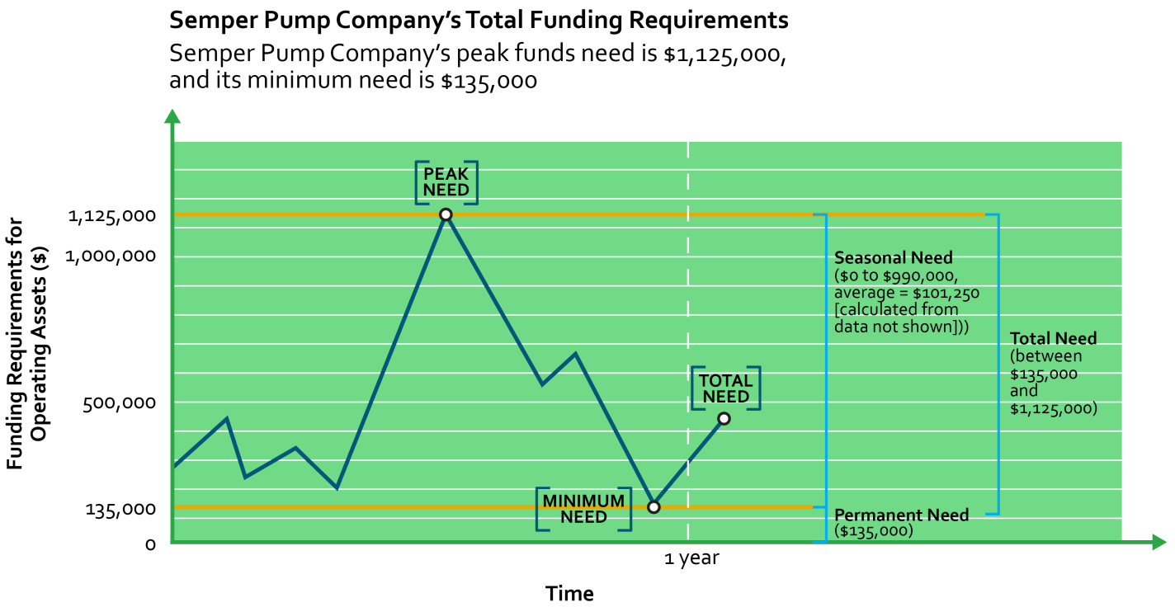
WORKING CAPITAL REQUIREMENTS VARY OVER TIME
Permanent vs. Project Funding Needs

Slide 10
CASHFLOW PROJECTIONS
Notes:
This kind of worksheet will allow your firm to project how much cash will be available at different stages of the project.

Slide 11
DISBURSEMENT MANAGEMENT
DELIVERY FLOAT
Time between contractor installing a component and payment approval.
PROCESSING FLOAT
Delay between receipt of check by general contractor and its deposit in subcontractor’s account.
CLEARING FLOAT
Delay between deposit of check and availability of funds.

Slide 12
WORKING CAPITAL PROJECTIONS
Review cashflow projection from your business plan.
What is the largest negative?
How much contingency should you add?
How will you address this need?
What percentage of the total WIP do you need?

Slide 13
WORKING CAPITAL SOURCES
Loans (bank, credit entities).
Equity (stock/partnership/ownership).
Factor cashflow.
Funds control.
Refinance long-term assets.
Owner contributions.
Reduce production to match funds.
Trade credit.

Slide 14
WHAT LENDERS WANT
Current cashflow.
Future contracts.
Solid collateral.
Guarantees, both personal and Government.
Smooth growth patterns.

Slide 15
SBA PROGRAMS TO INCREASE ASSETS
7(a) – loan program.
504 – hard assets.
CAPLines.
Notes:
7(a): https://www.sba.gov/blogs/sbas-7a-loan-program-explained
504: https://www.sba.gov/offices/headquarters/ofa/resources/4049
CAPLines: https://www.sba.gov/offices/district/mt/helena/resources/lenders-introduction-sbas-capline-programs

Slide 16
THE SBA 7(a) LOAN PROGRAM
Assist new, growing small businesses.
  Business are often startups, projection-based, had a change of ownership, or have limited collateral or equity.
Up to 90-percent financing.
Weighted average term.
Maximum funding up to $2 million.
Must be owner-operated.
Limited use for debt refinance.

Slide 17
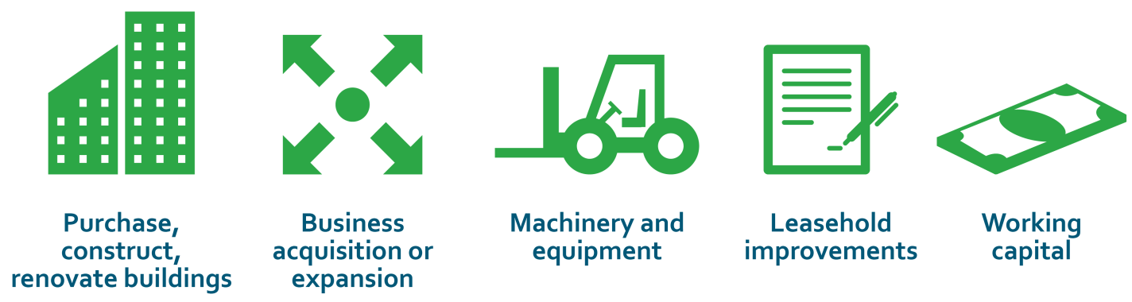
SBA 7(a) USE OF PROCEEDS

Slide 18
SPECIAL 7(a) LOANS
Contract loan program.
Seasonal line of credit.
Builder’s line of credit.
CAPLines.

Slide 19
TYPICAL 504 STRUCTURE
Total Project Costs
$1,000,000
$500,000 10 Year Maturity – Negotiable Rate
$400,000 20 Year Fully Amortized Fixed Rate Bond Market
$100,000 Borrower Contribution

Slide 20
TYPICAL 504 STRUCTURE (cont.)
50 / 40 / 10 90% FINANCING
50 percent private sector loan
40 percent 504 loan
10 percent equity (*startup/special use*)
Loan conditions:
  First lien position with a 50-percent loan-to-value ratio.
  20-year fixed rate.
  Requires equity injection of 10 percent.

Slide 21
ELIGIBLE 504 PROJECT COSTS
Land and building acquisitions.
New construction.
Building renovations/ leasehold improvements.
Major machinery and equipment with a minimum 10-year economic life.
Related costs, which can include:
  Acquisition-related legal expenses.
  Bridge loan points and interest.
  Construction. contingency, up to 10 percent.
  Professional fees.
  Eligible soft costs.

Slide 22
BUSINESS ELIGIBILITY
For-Profit and privately held.
“Small.”
Net Worth less than $15.0 million.
After-Tax income less than $5 million (2-year average).
Creates or retains jobs.*
Meets a public policy or community development goal of SBA.
* One job per $65,000 in 504 loan dollars

Slide 23
504 PROJECT STRUCTURE
PURCHASE PRICE | $1,000,000
APPRAISAL/ENVIRONMENTAL | $4,500
INTERIM LOAN INTEREST | $5,124
BANK FEE BRIDGE LOAN | $4,100
TITLE INSURANCE (BRIDGE/504) | $2,100
TRANSFER TAX | $10,000
TOTAL ELIGIBLE PROJECT | $1,025,824
BANK LOAN AT 50 PERCENT | $512,912
SBA LOAN AT 40 PERCENT | $410,330
EQUITY AT 10 PERCENT | $102,582

Slide 24
UNDERWRITING CONSIDERATIONS
CASHFLOW ANALYSIS | DEC. 31, 2014
REVENUES | $2,734
PRE-TAX EARNINGS | $1,122
PLUS DEPRECIATION | $16
PLUS INTEREST EXPENSE | $0
PLUS RENT SAVINGS | $169
PLUS OFFICERS’ COMPENSATION EXPENSE | $249
CASHFLOW AVAILABLE | $1,557
EXISTING DEBT SERVICE | $21
PROPOSED DEBT SERVICE | $308
OFFICERS’ COMP. NEEDED (40% PERSONAL D/I RATIO) | $385
CASHFLOW NEEDED | $714
CASHFLOW MARGIN | $843
CASHFLOW COVERAGE | 2.18
Proven management.
Cashflow Coverage
  Minimum 1:1 cashflow coverage based on historical operations or projections.
  Example of how to calculate cashflow coverage.
U.S. Dept. of Housing and Urban Development
U.S. Small Business Administration

Slide 25
504 LENDING LIMITS
Up to 40 percent of eligible 504 project costs:
  $1,500,000 maximum.
  $2,000,000 maximum for projects satisfying a public policy goal.
  $4,000,000 maximum for manufacturing.
Creating (or retaining) job opportunities:
  $50,000 per job.
  $100,000 for manufacturing.

Slide 26
SELF-EVALUATION
Take 10 minutes to review the loan checklist:
What does your firm have/need?
How long will it take to develop?
Who should be involved?
Report top two items to develop.

Slide 27
PART A: NEXT STEPS
Loan application to be completed in this session.
Participants list next steps in ongoing action plan.
  Quantify need in dollars.
  Identify sources.
  Research lender requirements.
  Draft applications.
  Self score: Would you invest?

Slide 28
RESOURCES
These attachments provide more information on Working capital:
SBA 7(a) Term Loan – Cashflow and Business Expansion Loan.
Article: How “Factoring” Provides Access to Working Capital.

Slide 29
PART B:
LOAN APPLICATION

Slide 30
PART B: INTRODUCTION
To obtain working capital, firms must borrow funds from lenders.
Firms must understand the lender’s requirement to minimize risk.
Borrower must demonstrate ability to repay.
Participants will draft a loan application and list next steps to complete it after course.

Slide 31
PART B: LEARNING OBJECTIVES
Understand application requirements and underwriting standards.
Identify and complete draft of loan application.

Slide 32
UNDERWRITING: LENDER’S VIEW
Lenders want to minimize risk.
On site, loan officer collects four forms:
  Balance sheet.
  Income statement.
  Cashflow analysis.
  Cross-check analysis (verification of the business’ viability other than the business owner).
These measures ensure that lenders make quality loan-approval decisions.

Slide 33

COMPONENTS OF THE BUSINESS ASSESSMENT:

Slide 34
1. CHARACTER
Assess the personal reputation of the business owner:
Reputation and place in community.
Residence legality.
Type of dwelling (property, quality).
Family general income.
Family general expenses.
Support for a loan and business by family members.
Psychological and emotional stability.
Entrepreneur’s experience in business.
Credit history (moneylenders, family, suppliers, relief fund).

Slide 35
2. CAPACITY
Assess the viability of the business:
Business age.
Regular suppliers’ strength.
Volume of contracts.
Number and status of workers.
Procedure to provide services.
Equipment necessary for efficient production.
Average gross income or profit.
Automation of management/accounting.

Slide 36
3. CAPITAL
Assess the liquid financial resources of the business:
Client financial resources.
Equity.
Borrowed funds.
Percentage of subcontracted work.
Turnover by days (cycle of business activity).
Volume of contracts.
Frequency of draws.
Accounts and reporting skill.

Slide 37
4. COLLATERAL
Assess the assets and guarantees available to pay loan:
Title to assets.
State and property reliability.
Legal right to sell property.
Realistic value of property.
Psychological importance of a guarantee .
Guarantor’s ability to repay indebtedness.
Borrower’s and guarantor’s motivation/willingness to repay indebtedness.

Slide 38
5. CONDITIONS
Conditions beyond business owner’s control (e.g., seasonality, competitiveness, inflation, access to suppliers, abnormal weather).
In order to assess the above conditions, you must:
Understand the local economy.
Research Government regulations affecting small businesses.
Rank competitive advantages of the business.
Account for specific loan conditions:
  Amount.
  Maturity.
  Amortization.

Slide 39

POTENTIAL ISSUES
Incomplete, inaccurate, or misleading information.
Not considering business seasonality.
Misunderstanding of family involvement in business.
Inaccurate assessment of how loan will affect future business growth.
Insufficient time and attention paid to how a client will use loan.

Slide 40
EVALUATION OF STRENGTHS
Business location/sales outlets.
Business type and its turnover/type of goods or services.
Legality/legal status.
Demand/seasonality.
Range of goods/business volume.
Suppliers.
Business costs.
Credit history/debts.
Markup.
Additional income sources.
Competitiveness.
Owner’s health status.
General economic position of the business.

Slide 41
LOAN TYPES
SBA 7(a)
504
Bank loan
Investor loan
Equity loan
Other

Slide 42

SELECT A LENDER
Who do you know now?
Bank
Credit union
Broker

Slide 43
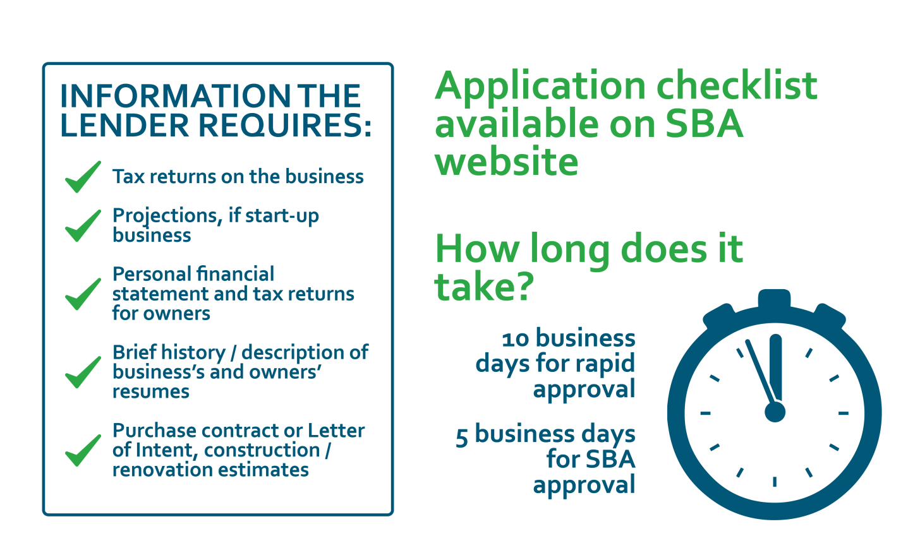
READINESS CHECKLIST

Slide 44
ADDITIONAL ISSUES
Questions from attorney, CPA, insurance carrier.
Title insurance issues.
Life insurance/assignment.
Organizational documents.
Construction/subcontractors – lien waivers.
Personal history (Form 912).
Other contracts.
Note: Address any special circumstance early.

Slide 45
LOAN APPLICATION EXERCISE
Select a loan source.
Take 20 minutes to:
  Review application form.
  What information is difficult to provide?
  How will your firm respond?

Slide 46
PART B: NEXT STEPS
Each participating contractor undertakes preparation of “real” loan application:
Complete drafts of all sections, to the extent possible.
Identify incomplete elements in action plan to finish and submit loan application.
Review list with facilitator to see whether any updates or revisions are needed.

