Slide 2
SMALL CONTRACTORS INITIATIVE
SESSION 1
INTRODUCTION
TO BONDING AND
BUSINESS PLANNING

Slide 3
WELCOME
Introductions
Course overview
Sponsored by the U.S. Department of Housing and Urban Development (HUD)
  Delivered by a local intermediary.
Notes:
Presenters introduce themselves, discuss background and experience related to the course.
Depending on number of participants, have them introduce themselves. Can ask for their background, current employment, reason for attending.

Slide 4
COURSE OVERVIEW
Session 1: Introduction to Bonding and Business Planning
Session 2: Requirements: Applicability & Reporting
Session 3: Business Planning
Session 4: Financial Management
Session 5: Working Capital and Loan Applications
Session 6: Contracting Opportunities
Session 7: Bonding
Session 8: Wrap-up

Slide 5
SESSION OVERVIEW
Part A: Bonding
  Surety Bond Basics
  Bonds vs. Insurance
  Types of Surety Bonds
  Why Get a Bond?
  Underwriting: Capacity, Financial Strength, Character, Guarantee
Part B: Business Plan
  Why Plan?
  Parts of a Business Plan
  Examples
Resources

Slide 6
PART A:
INTRODUCTION TO BONDING

Slide 7
LEARNING OBJECTIVES
Learn why bonds are important and desirable for your business.
Learn the history of bonds and the different types of bonds.
Learn how to obtain performance bonds.
Identify criteria and/or documentation your company already has in place and what to focus on during course.

Slide 8
HISTORY OF BONDING
Surety bonds have existed for thousands
of years.
  First known example is from 2750 BCE:
    A Mesopotamian tablet stated that a farmer would work another farmer’s field because he had to serve in the army. The two farmers agreed to
    split the profit evenly. A local merchant served as the world's first known surety
    by guaranteeing that the second farmer would keep his word.
  In the mid-1800s, surety companies were established in the
  United States and England.
  In 1894, Congress passed the Heard Act, which required surety bonds on all federally funded projects.
Bonds provide a guarantee against failure
to perform work.
Notes:
Source: https://www.suretybonds.com/edu/history.html; this is a timeline for surety bonds.

Slide 9
SURETY BOND BASICS
A surety bond is defined as a contract among at least three parties:
The obligee: The recipient of an obligation (e.g., the U.S. Government).
The principal: The primary party who will perform the contractual obligation (e.g., your business).
The surety: The party who assures the obligee that the principal
can perform the task (e.g., the bonding company).
What is a surety bond?
  “Essentially, a surety bond is an insurance policy between the contractor, the client, and a third-party surety bond company that covers your promise—and ability—to complete the terms of a contractual agreement. Instead of you having to put up cash as a deposit, you get a surety bond.”
  -Nico Janssen, U.S. SBA
Notes:
Source of quotation: https://www.sba.gov/blogs/sba-surety-bonds-pt-1-whats-surety-bond-and-when-do-i-need-one
The contractor obtains a surety bond from a surety company. If the contractor defaults, the surety company is obligated to find another contractor to complete the contract or compensate the project owner for the financial loss incurred.
A surety bond ensures contract completion in the event of contractor default. A project owner (called an obligee) seeks a contractor (called a principal) to fulfill a contract.

Slide 10
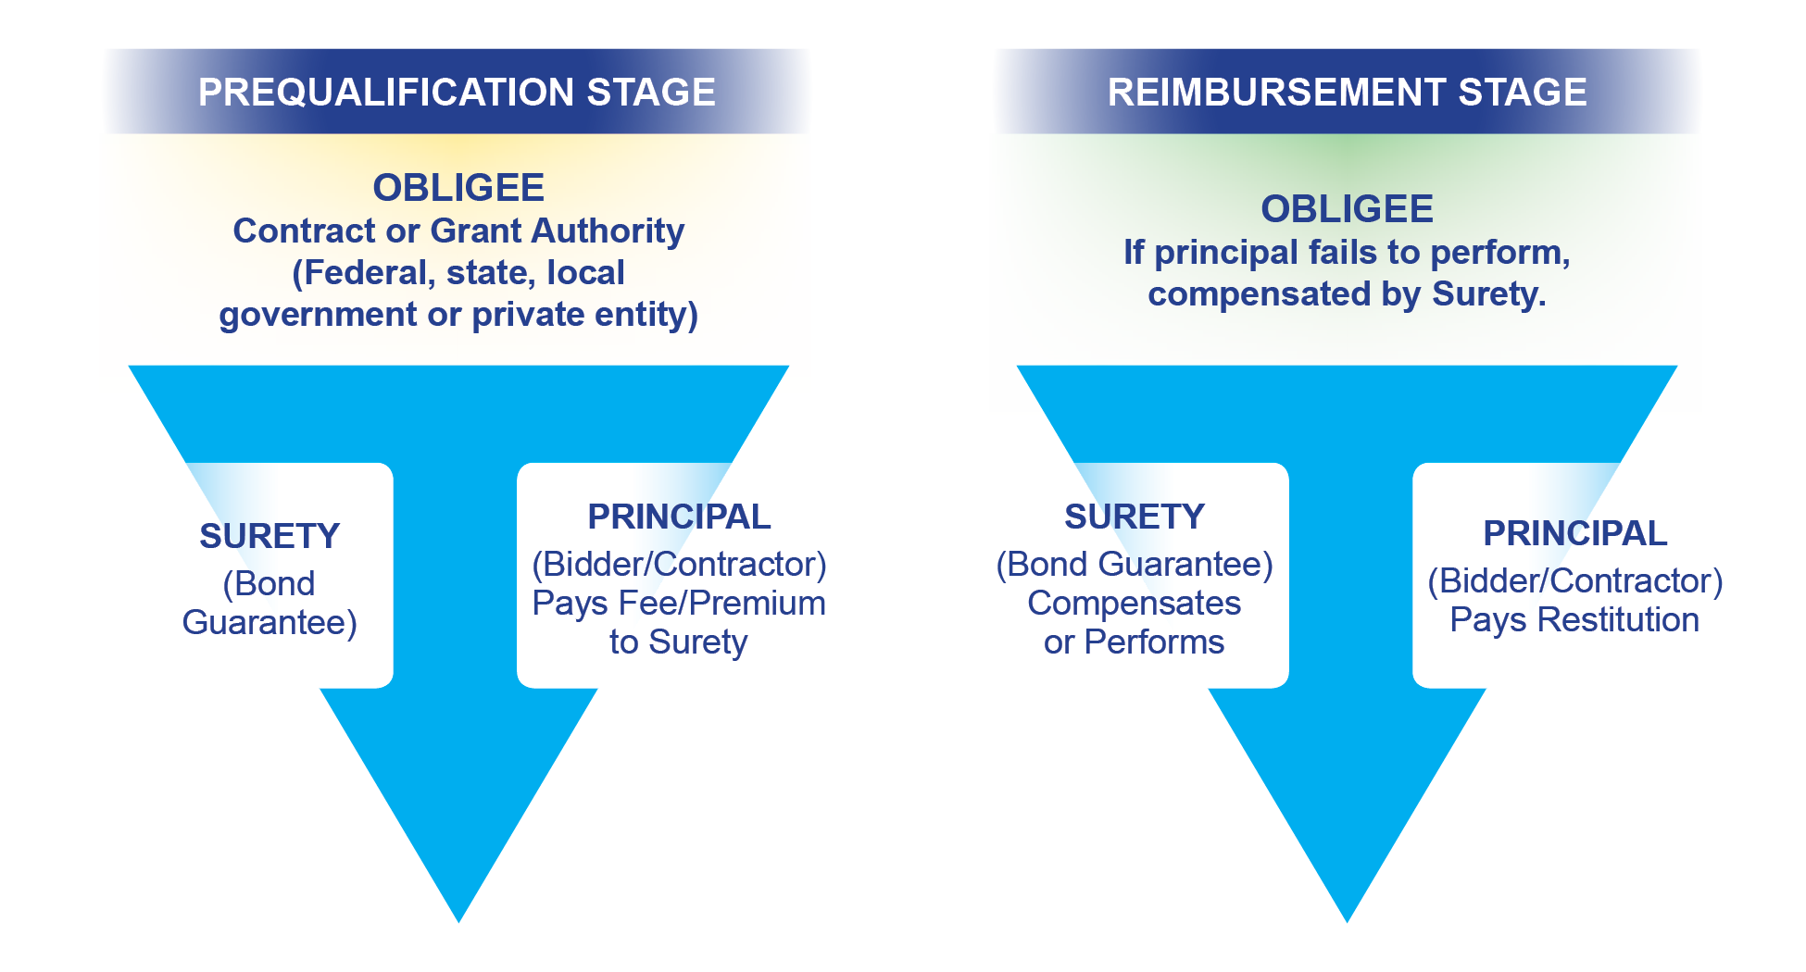
BONDS IN ACTION

Slide 11
DO I NEED A SURETY BOND?
Establishes your company as credible and capable.
Lowers the risk of hiring your company.
May be required by an agency, owner, or general contractor—will therefore allow you to access more opportunities.
Federal construction contracts over $150,000 require surety bonds, as do most State and municipal governments and many private entities.

Slide 12
BONDS vs. INSURANCE
  Insurance policies cover damages or loss to people or property.
  To get fire insurance, you pay a premium.
    If the house burns, insurance covers the cost to rebuild.
    Insurance does not cover losses if a contractor fails to perform.
  To get a bond, you also pay a premium.
    If you default on your contract, the surety ensures that the work is completed
    and everyone is paid.
    The surety then looks to you to recover all their losses.
Notes:
Add more details…

Slide 13
TYPES OF SURETY BONDS
BID BONDs ensure that the bidder on a contract will enter into the contract and will furnish the required payment and performance bonds if awarded the contract.
PAYMENT BONDs ensure that suppliers and subcontractors are paid for work performed under the contract.
PERFORMANCE BONDs ensure that the contract will be completed in accordance with its terms and conditions.
ANCILLARY BONDs ensure that requirements integral to the contract, but not directly performance-related, are performed.

Slide 14
WHY GET A BOND?
Construction is a risky business.
According to BizMiner, one in four contractors fails.
The owner should rely on a surety bond for the best protection on a project.
The surety guarantees that the contractor has the means to complete the project.
Notes:
No matter an owner’s relationship with a contractor, the owner should rely on a surety bond for the best protection on a project.
The surety prequalifies the contractor to guarantee, in the surety’s opinion, that the contractor has the capital, capacity, and character to complete the project.

Slide 15
KEY UNDERWRITING CRITERIA
Capacity and Experience
Financial Strength (Business and Personal)
Character and Management
Guarantee
What is surety underwriting? It is the process of vetting the business to decide on the risks that the suretor is willing to take. The bonder must review the business’s status to understand whether it can take the risk of issuing the bond.

Slide 16
1. CAPACITY and EXPERIENCE
Can I manage the construction work and business aspects of the job?
  Abilities.
  Management.
  Work experience.
  Company history.
How will I demonstrate that I have the capacity?
  Business Plan.
  Track record.
  Licenses and certifications.

Slide 17
2. FINANCIAL STRENGTH
Does your business have a demonstrated ability to manage its finances well and maintain working capital?
  Financial history.
  Financial management systems.
  Working capital available.
How will I demonstrate this?
  Financial statements.
  Systems in place, or supports available.
  Cash on-hand and/or line of credit.

Slide 18
3. CHARACTER and MANAGEMENT
Can your firm be trusted to deliver on its commitments and complete the work, even if
it encounters problems on the job?
How will you demonstrate this?
  Personal and corporate history and references.
  Credit.
  Evidence of clearing up past problems.
  Continuity plan.

Slide 19
4. GUARANTEE
If your capacity and financial strength are not enough, how can you give the surety the confidence they need that they will not suffer
a loss on this job?
  Funds control:
    Proper control by management to ensure authorized use.
  Collateral:
    Security pledged for payment of a loan.
  Co-Obligee or partner.
  SBA Bond Guarantee.

Slide 20
REVIEW OF KEY IDEAS
Key components designed to help you establish
your qualification for a bond:
  Business planning.
  Financial management.
  Working capital.
  The bonding process.
Other components will help you search for contracting opportunities and understand likely benefits and challenges of those opportunities:
  Procurement and partnering.
  Federal requirements.

Slide 21
LINK TO ACTION PLAN
Contractors review their draft Action Plan.
  We will identify where each action item is addressed in the course.
  Review with facilitator for required updates
  or revisions.
Participants share highlights of their Action Plans with the cohort.

Slide 22
BONDING RESOURCES
Links with detailed information on bonding:
SBA, “Surety Bonds.”
JW Surety, “What is a Payment Bond?”
Surety Information Office, “How to Obtain Surety Bonds.”
Donahue & Thomas, “Construction Surety Bonds In Plain English.”
Attachments with more information on bonding:
Performance Bond Application
Payment Bond Application
Surety 101
Notes:
SBA, “Surety Bonds” – https://www.sba.gov/funding-programs/surety-bonds
JW Surety, “What is a Payment Bond?” – http://www.jwsuretybonds.com/edu/payment-bond.
Surety Information Office, “How to Obtain Surety Bonds” – http://suretyinfo.org/?wpfb_dl=57.
Donahue & Thomas, “Construction Surety Bonds In Plain English” – http://www.attny.com/gci32djd.html.

Slide 23
PART B:
INTRODUCTION TO BUSINESS PLANNING

Slide 24

LEARNING OBJECTIVES
Understand how this course will help to prepare a business plan.
Understand what a business plan is.
Understand how a business plan will aid
in obtaining a bond.
Identify the essential sections of a business plan that are required for a bonding application.
U.S. Dept. of Housing and Urban Development
U.S. Small Business Administration

Slide 25
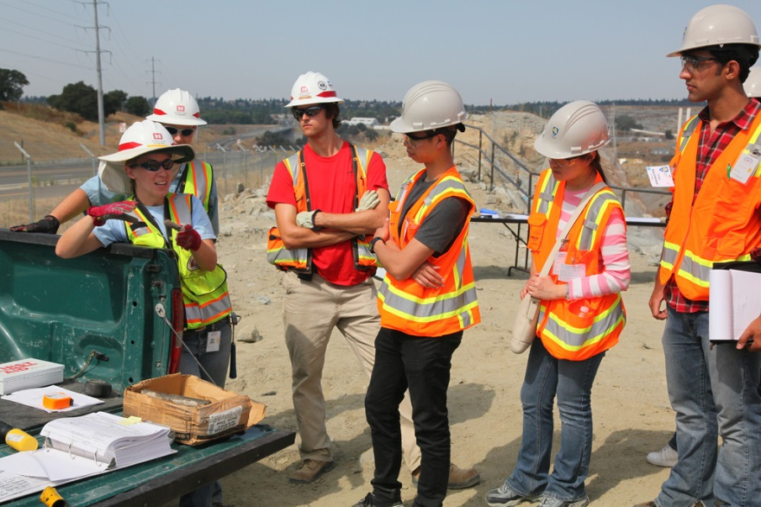
WHY PLAN A BUSINESS?
Avoid failure.
Apply for a working capital loan.
Receive a bond.
Grow your business.
https://www.flickr.com/photos/usacehq/6141166487

Slide 26
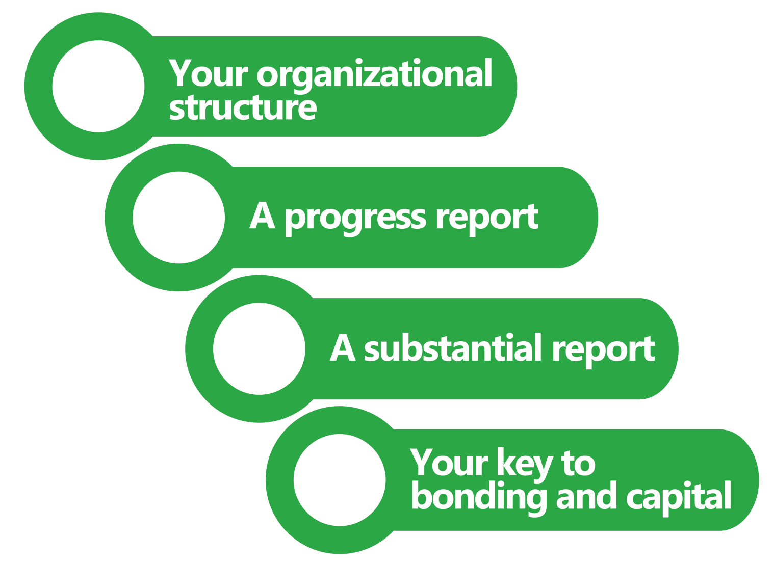
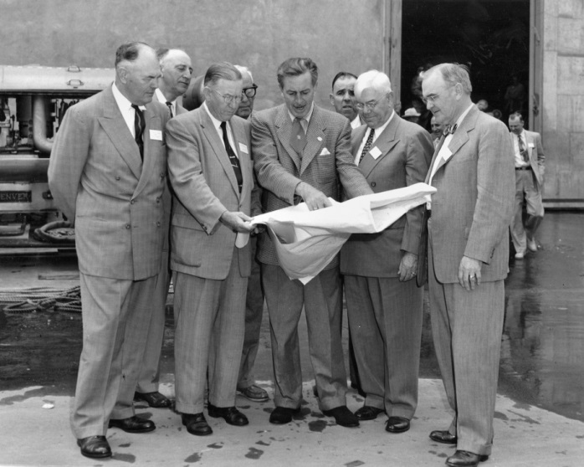
A BUSINESS PLAN IS…
https://www.flickr.com/photos/ocarchives/3952964087/

Slide 27
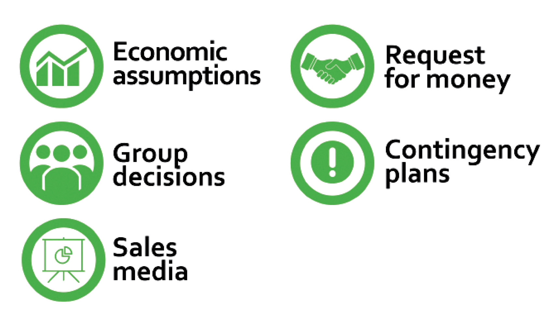
BUSINESS PLANS CONTAIN:

Slide 28
A BONDABLE PLAN…
Is feasible and realistic.
Indicates pipeline.
Offers sophisticated management and accounting.
Highlights profit.
Provides continuity.
Proves capacity.
Provides a good financial and operational picture of the business.

Slide 29
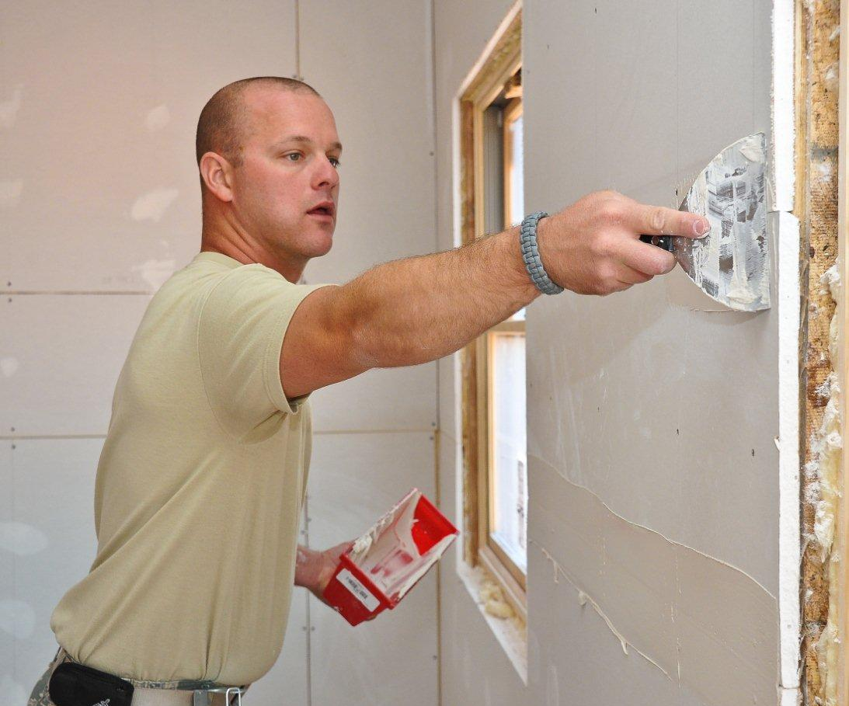
EXAMPLES OF PLANS
Large general contractor.
Small general contractor.
Electrical subcontractor.
https://www.flickr.com/photos/ganatlguard/5891371057

Slide 30
WE WILL USE…
Reference manual.
Business Plan template.
Examples.
Your business.
Mentoring site visits.
Multiple edits.

Slide 31
BUSINESS PLAN TEMPLATE
On USB drive.
Word document.
Excel workbooks.
PowerPoint shell.
Rename file.
Two-minute cover page.

Slide 32

8 PLANNING STEPS
Clarify vision & mission
Project financials
Describe your business
Marketing for image & products
Verify your environment
Identify & defeat risk
Build a team
Revise, develop, sell

Slide 33
CREATING YOUR BUSINESS PLAN
How will you create a powerful document?
  Who
  When
  What
List tasks for preparing company-specific business plan.
  Due dates
  Assignments

Slide 34
HOW WILL YOU BEGIN?
DESCRIBE YOUR BUSINESS:
THE 1-HOUR BUSINESS PLAN APPLICATION

Slide 35
PLANNING RESOURCES
Links with detailed information on business planning:
Business planning software.
  Bplans: The Complete Guide to Business Planning
  Business Plan Pro: Business Planning Software Solution
National Association of Home Builders (NAHB)
  Market analysis.
  Markup benchmarks.
US Small Business Administration
  Learning Center.
  Create Your Business Plan.
Notes:
Business planning software
https://www.bplans.com/
http://www.businessplanpro.com/
National Association of Home Builders website – https://www.nahb.org/
SBA website – https://www.sba.gov/

