Slide 1
Detecting and Addressing Hazards from Mold
Produced for U.S. Department of Housing and Urban Development April 2020
All photographs, drawings and illustrations used in this presentation are the property of their respective copyright owners and are used for educational purposes only. To the best of our knowledge, all photographs, drawings and illustrations used herein fall under the fair use or public domain guidelines of copyright law in the United States. Photographs, drawings and illustrations used herein are intended to help demonstrate various types of mold and mold conditions a PHA employee may encounter in typical residential settings. This course, in its entirety, including, but not limited to, all written materials, images and illustrations are intended to provide examples of the conditions a maintenance employee may experience in a typical residential setting. Proper precautions should be taken when suspected mold conditions are encountered.

Slide 2
Detecting and Addressing Hazards from Mold Topic 4: Types of Assessment
See Chapter 4 of the Course Handbook

Slide 3
Topic 4 Objectives
Describe a non-intrusive visual assessment.
Describe an intrusive or scientific assessment.
Discuss what to look for when doing an assessment.

Slide 4
Types of Assessment
Non-Intrusive/Visual Assessment | Intrusive/Scientific Assessment
Lowest level Visual analysis of current conditions Used as a basis for determining next steps | Swabs Tapes Bulk samples Air sampling
4-1

Slide 5
Purpose of Non-Intrusive Assessments
Report moisture intrusion
Note water damage
Note apparent mold growth
Record the presence of musty odors
Report conditions conducive to mold growth

Slide 6
What is Involved in a Non-Intrusive Assessment?
Visual inspection for signs of moisture
Taking pictures
Moisture and temperature readings
Cutting or drilling into building materials
Taking samples

Slide 7
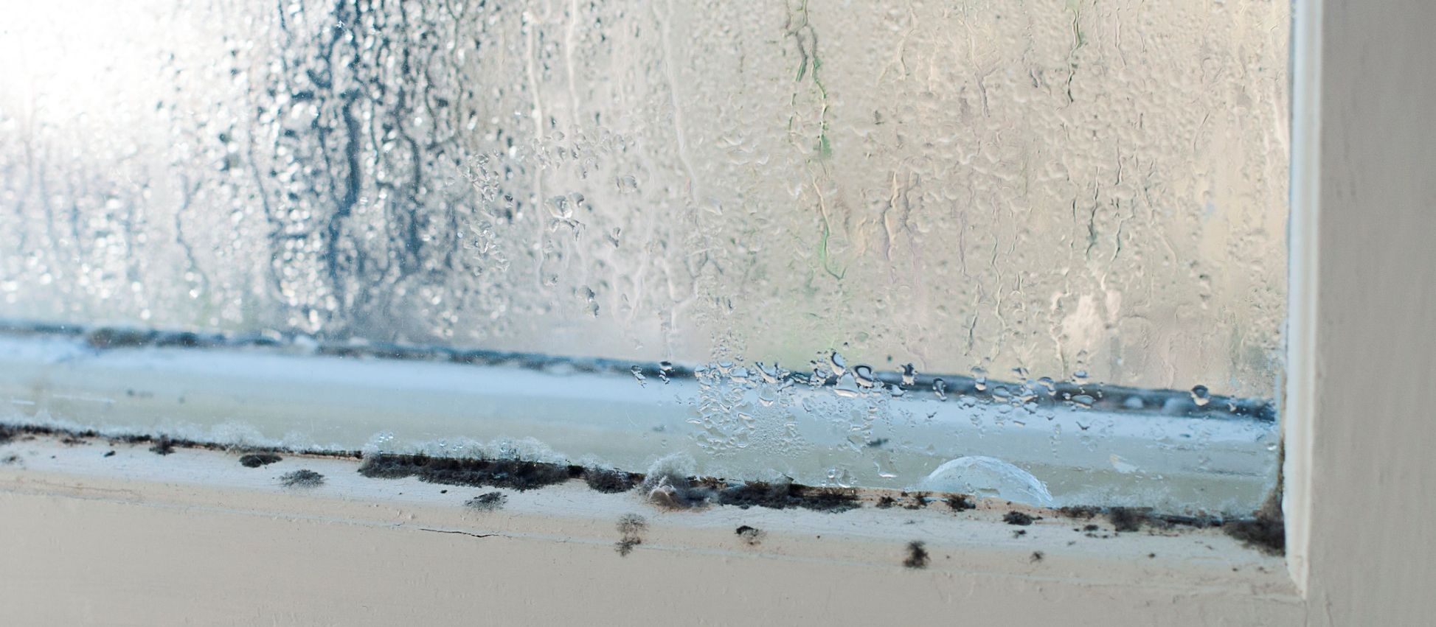
Non-Intrusive Assessment

Slide 8
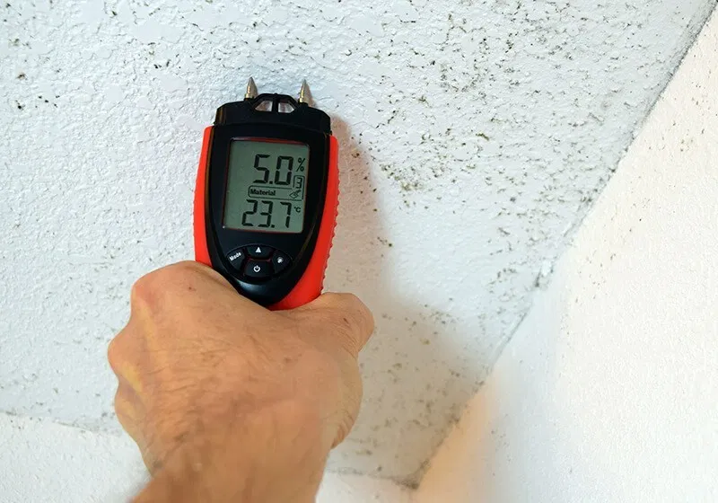
Moisture Testing of Building Materials
The moisture meter being used in this photo determines the water content of the surface and interior of the wall. High moisture favors mold growth.

Slide 9
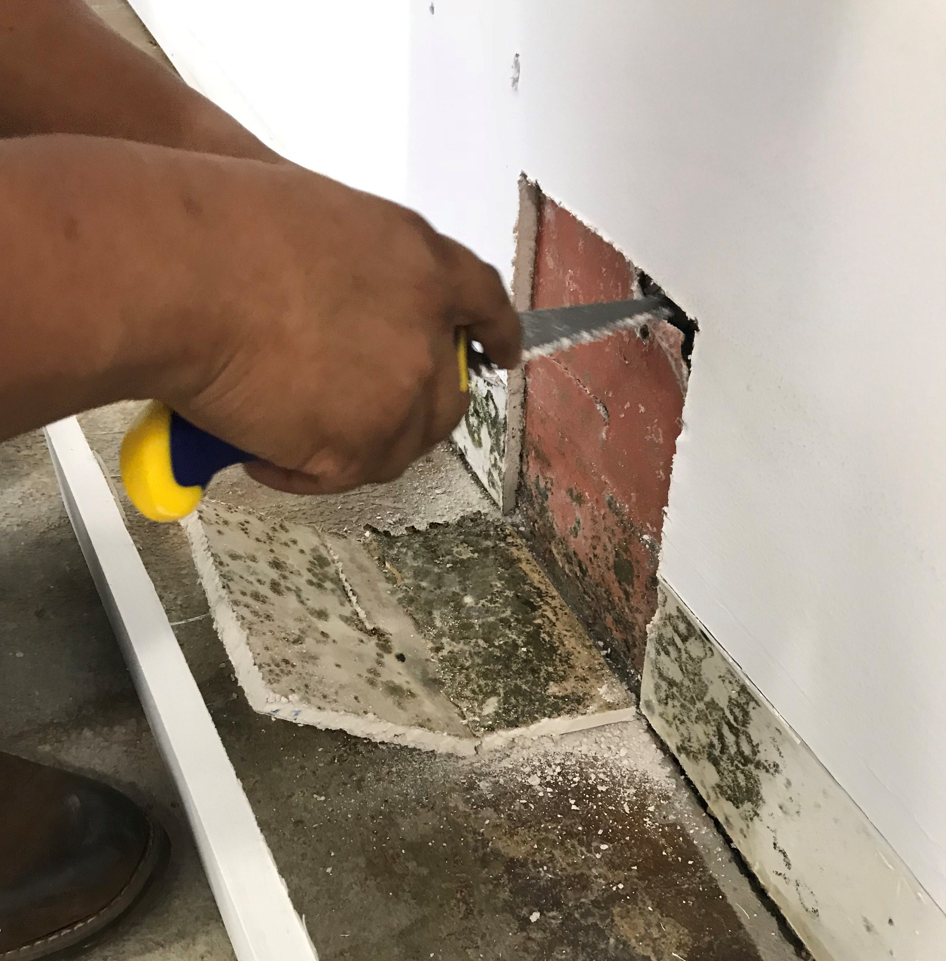
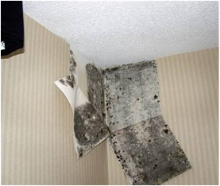
Intrusive Assessment

Slide 10
Use Your Senses
Look for substances that appear cottony, velvety, granular or leathery, and have varied colors, including white, gray, brown, black, yellow, and/or green.
Mold often appears as discoloration, staining, or fuzzy growth on the surface of building materials and furnishings.
Walk around the outside of the property as well as the inside.
Don’t forget your sense of smell!

Slide 11
What to Look for Outside the Unit
Grading and discharge of roof water
Presence of standing water
Condition of exterior siding and trim around doors and windows
Rodent or pest intrusion
Poor condition of roof

Slide 12
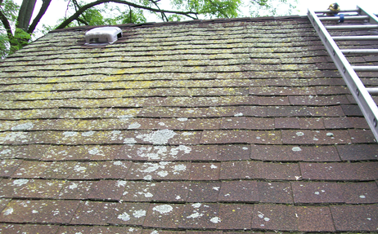
Deferred Maintenance on a Roof

Slide 13
What to Look for Inside the Unit
Examine patched surfaces and look for stains and water marks.
Measure for wet, damp, and moist areas.
Check for leaks and signs of previous leaks and repairs.
Check exhaust fans and vents and the locations where they discharge.

Slide 14
What to Look for Inside the Unit (continued)
Check HVAC systems, humidifiers, and dehumidifiers, including drip pans and coils fins.
Enter crawlspaces to ensure there are no insulation or ventilation problems or condensation on pipes.
Inspect basements, checking masonry walls for efflorescence, and checking that the sump pump is working.
Check attics for proper ventilation and insulation.
Note any musty odors!

Slide 15
When to Bring in a Third Party
Consider bringing in a professional mold remediation contractor or certified mold inspector when:
The source of the mold is uncertain
The mold has an effect on the structure or aesthetics of the building
Litigation is involved
The resident has health concerns
The mold professional will likely conduct a scientific assessment, which collects samples and has them tested in a laboratory.
Scientific assessments help provide evidence of the scope and severity of a mold problem.

Slide 16
Topic 4 Key Takeaways
Conduct a non-invasive, visual assessment of the readily accessible, visible, and installed systems and components when you receive a complaint or concern about possible mold.
Use your senses to look for mold hazards in your everyday work.
Don’t guess! Not everything that looks like mold is mold.
Never try to diagnose or comment on possible mold-related health problems.
Know when to seek advice of a licensed or certified mold inspector or assessor.

Slide 17
Thank you for your participation. Please continue to Topic 5: Remediation

